Slide 1

California Housing Prices
Project 4 - Cameron DiFalco

Slide 2
Problem Statement
California has a diverse range of housing prices that are influenced by a variety of factors such as location, age of the house, and economic conditions.
Despite having a wealth of data, the relationship between these variables and the median house value is not well-understood, this leads to sellers and buyers often bartering for a price that makes both parties happy.
There is an increasing need for stakeholders, such as homebuyers, policymakers, and investors, to better understand how these variables interact to affect housing prices.
My reason for picking this topic is I’m currently looking at buying a house and want to understand how America vs Australia housing markets compare and what the main differences are.

Slide 3
Project Aim
To analyse the available dataset and identify the most significant variables affecting median house values in California.
Show a variety of graphs to assist with qualitative reasoning.
To develop a predictive model for estimating median house prices based on key variables.
To provide actionable insights that can aid stakeholders in making informed decisions regarding California housing.

Slide 4
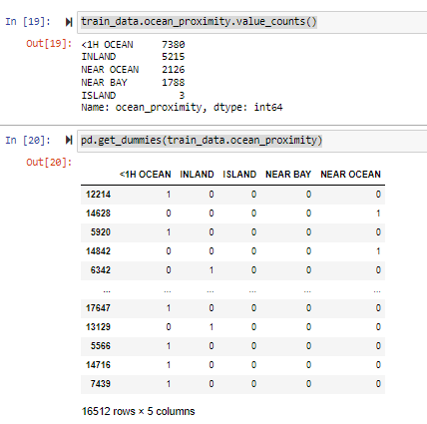
Reviewing the Data Set
I loaded and reviewed the data in a csv/excel document to get a general understanding of the data.
One of the columns had some missing values so I used data.dropna to remove the empty rows from our dataset.
We've converted the text-based "Ocean Proximity" column into separate columns for each category to facilitate better correlation analysis.
We split the data to allow for a testing environment and a data set we can evaluate against later in the process.

Slide 5
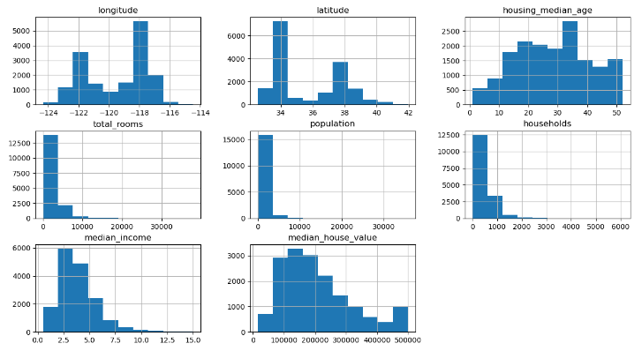
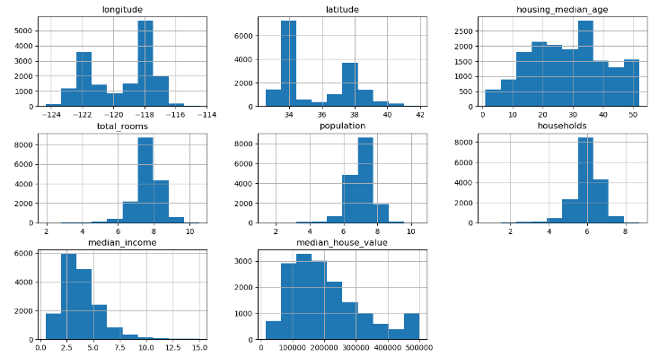
Reviewing Data
Using some logarithmic massaging to make the data look a little cleaner we have the histograms looking more bell shaped.
Notes:
Positively skewed or right skewed, which is funny because it's kind of the opposite.

Slide 6
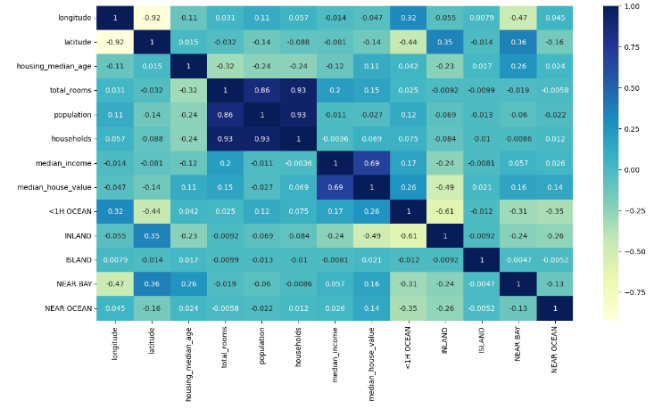
Correlation Matrix
Notes:
Looking at the big blue square, we have a combination of population, rooms, and households all correlating to higher prices
Median House Values and Median Income was the highest correlation 0.69 – probably has something to do with higher salaries can afford higher housing costs
Under 1 Hour to Ocean seems like a good predictor to high price 0.26
Inlane has low correlation (-0.49) further the cheaper
Obviously its hard to be inland and close to ocean so that was negatively correlated at -0.61

Slide 7
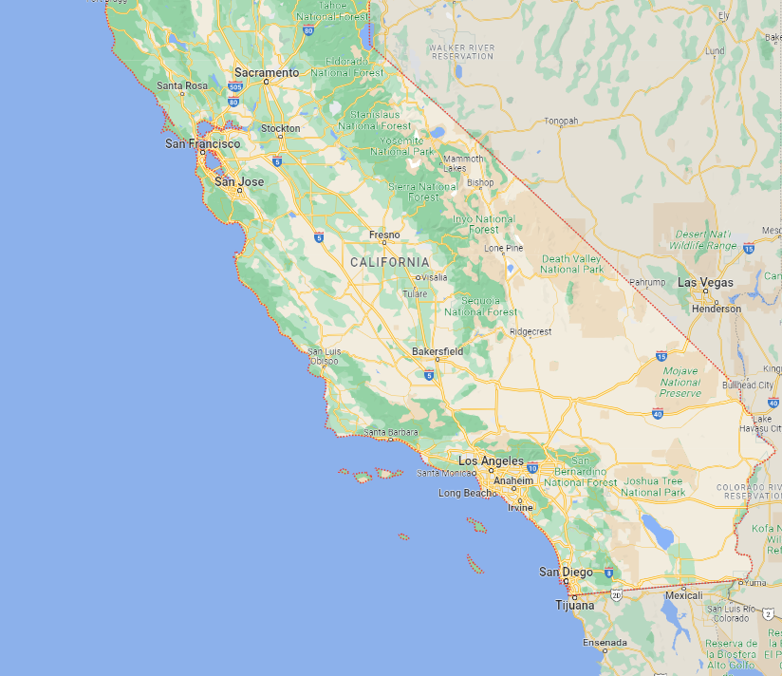
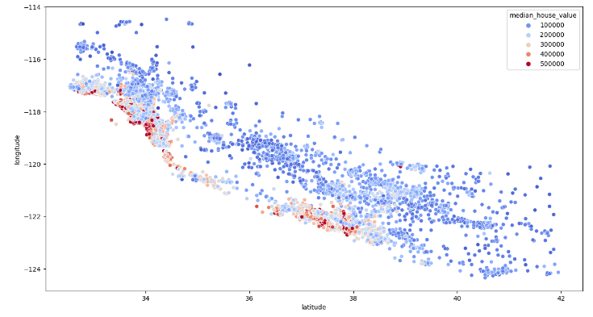
Plotting the Longitude and Latitude
Can you spot the similarities?

Slide 8
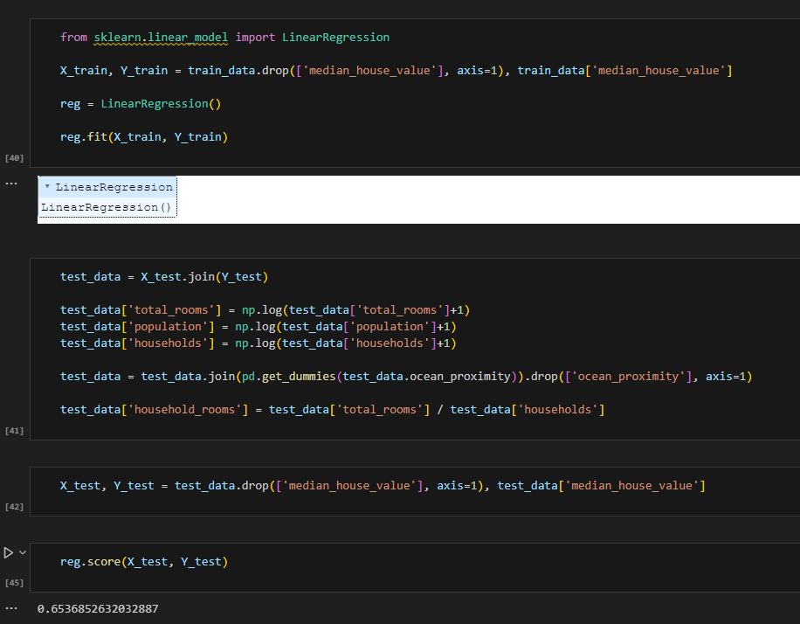
Machine Learning
Now that we have a fair understanding of the models, we can test our hypothesis that median income influences house prices.
Using sklearn and linear regression functions we will look at using the test and training modules we split earlier in the project to test our hypothesis.
Regression = 0.6537…..
Using Random Forest Regression….
Forest. Score = 0.2885….

Slide 9
What could have been done better?
I could have scaled the data, this may have given us a better result but due to time and ability of programmer (me) there were some issues.
More functions should have been used as writing long formulas caused issues and made troubleshooting more difficult.
After some research I noticed some machine learning modules can be X times Y to create a new variable, this might have been helpful for longitude x latitude. This was just a little advanced for my skills at this stage of a course.

Slide 10
References
Thank You!
https://www.kaggle.com/datasets/camnugent/california-housing-prices?datasetId=5227&sortBy=voteCount

